Slide 1
Kotlin
TYBCA – SEM 5
SDJ International College,
Vesu, Surat

Slide 2
Kotlin Overview
JVM Language
It need JVM (Java Virtual Machine) to execute its bytecode.
Support to avoid NullPointerException
Supports Immutability
Object Oriented Language
Functional Oriented Language
You can pass function as parameter to another function
Function can return another function
Less code
Less code, clean code, more results.

Slide 3
Evoltion
July, 2011
Kotlin Unveiled by Jetbrains
Feb, 2012
Kotlin Open sourced
Feb, 2016
Kotlin v1.0 released
May, 2017
Google I/O
Kotlin adopted as Android Official Language

Slide 4
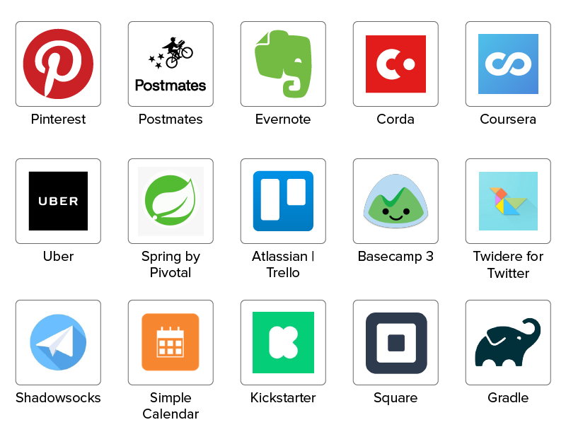
Apps built in kotlin

Slide 5
Types of App built in kotlin
Server Side Apps
Android Development
Web Development
Desktop Application
Native Development

